Slide 1
AI-Powered Accident Cause Identification
Jyothy Das, Jemima IV, Meenu PV

Slide 2
Problem statement
This project aims to analyze accident reports to extract primary cause, secondary cause and risk factors.

Slide 3
Objective
Develop an NLP(natural language processing) based system to identify accident cause from accident report.
Implement a chatbot to extract accident cause from accident report and display it.

Slide 4
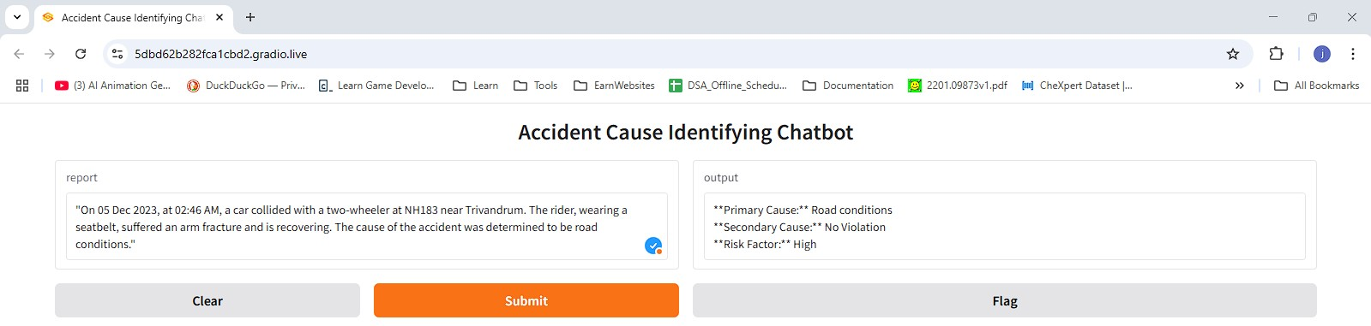
Accident cause identification chatbot (Using Gradio)

Slide 5
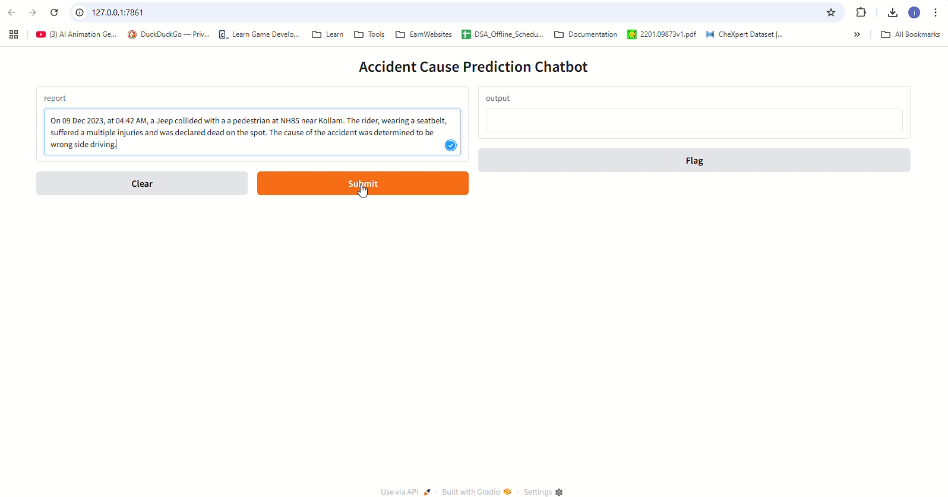
Video of chatbot

Slide 6
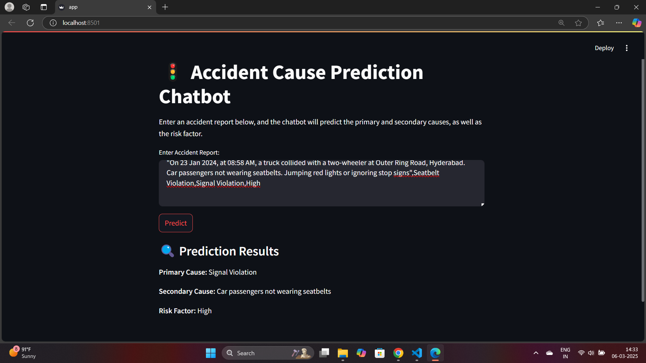
Chatbot(Using streamlit)

Slide 7
Related facts
According to the World Road Statistics, India recorded the highest number of road accident deaths across 199 countries in 2018 followed by China and the US.
According to government data, more than 1.5 lakh people lost their lives in road crashes in the country in 2018.
Of the total people killed in road crashes in 2018, 48% were between 18 years and 35 years old, and more than 60% of such fatalities were due to overspeeding.

Slide 8
Related Govt Projects
Integrated Road Accident Database (iRAD) :
Goal: Improve road safety in India.
Initiative of the Ministry of Road Transport and Highways (MoRTH).
Funded by World Bank.
Establishment of an accurate and uniform road accident data collection mechanism from all over India.
For this purpose, iRAD mobile & web application is developed.
This will facilitate road accident data collection by 4 stakeholder departments 1.Police 2.Transport 3.Highways 4.Health Departments
The collected data will be analyzed using different data analytics technique for identification of accident-prone areas and causes of the accidents.
NICSI(National informatics centre services) & IIT Madras have been jointly entrusted to carry out design, Development, Training, and implementation of iRAD project

Slide 9
References
Ministry of road transport and highways
iRAD ()

